Slide 1
WELCOME TO PARENT INFORMATION NIGHT
Transitional Kindergarten
Mrs. Ochoa - AM
Mrs. Somerville/Ms. Cintra do Prado - PM

Slide 2
Communication Connection
Website: www.chino.k12.ca.us/Chaparral
School Phone: (909) 606-4871 – Chaparral ext. 6204, Room E-4
Teacher emails:
Monica_Ochoa@chino.k12.ca.us
Carol_Somerville@chino.k12.ca.us
Theresa_CintraDoPrado@chino.k12.ca.us
Teachers prefer Class Dojo for communication

Slide 3
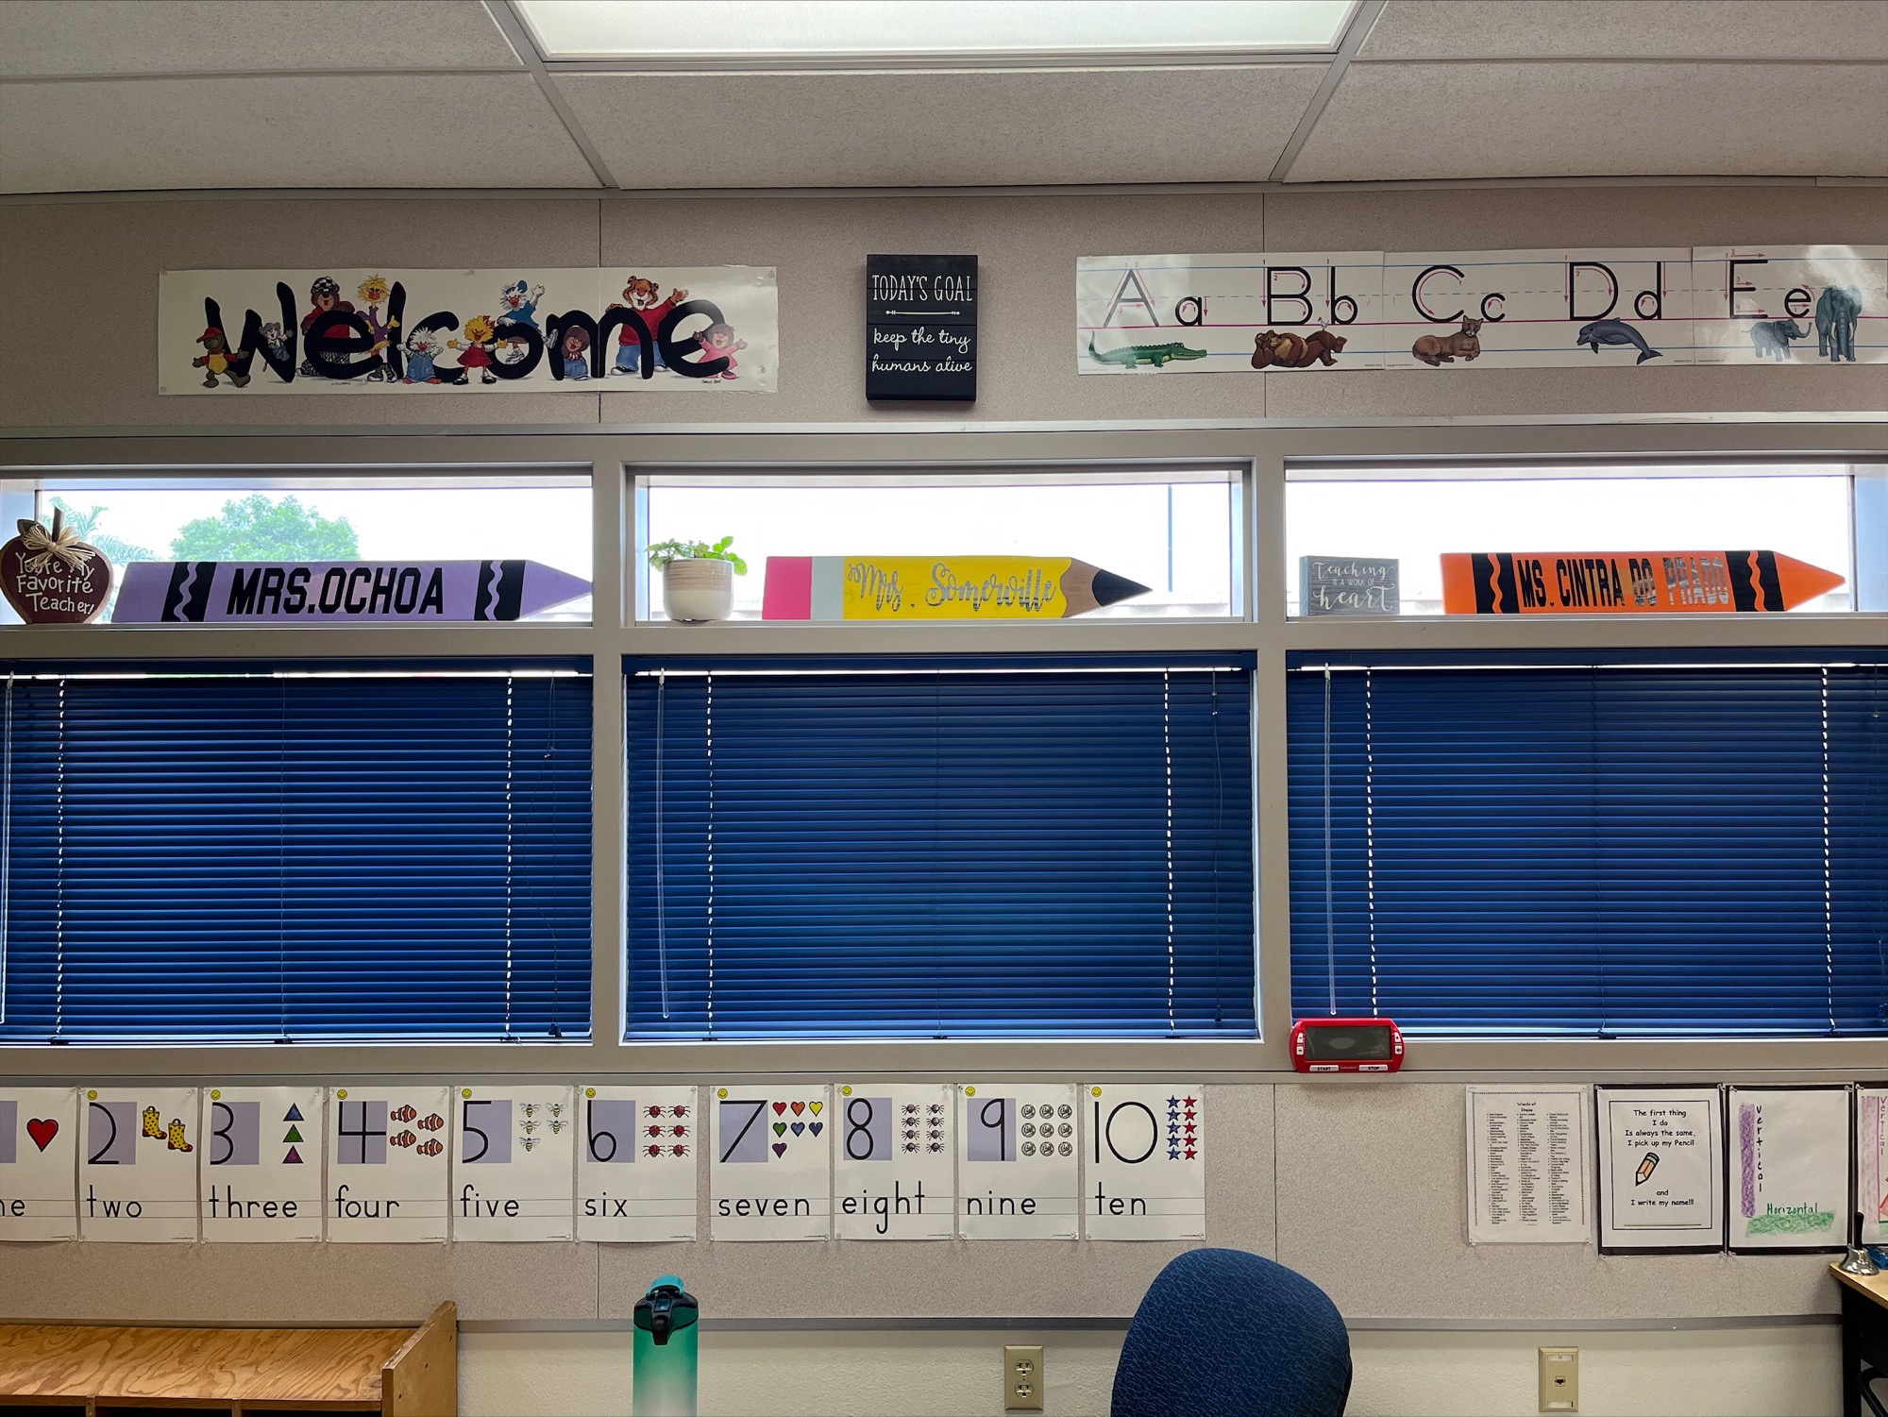
Your TK Team

Slide 4
Theory of Multiple Intelligence
Domains of Intelligence
Linguistic (Word Smart)
Logical/Mathematical (Number Smart)
Spatial (Picture Smart)
Musical (Music Smart)
Bodily/Kinesthetic (Body Smart)
Interpersonal (People Smart)
Intrapersonal (Self Smart)
Naturalist (Nature Smart)

Slide 5
TK Curriculum
These are the areas that are incorporated into our instruction to meet the readiness standards:
Social-Emotional Development
Phonemic Awareness
Alphabet Recognition
Math Concepts
Print Awareness
Oral Language and Vocabulary
Literature/Listening Comprehension
Writing
Physical Development
Involving Families

Slide 6
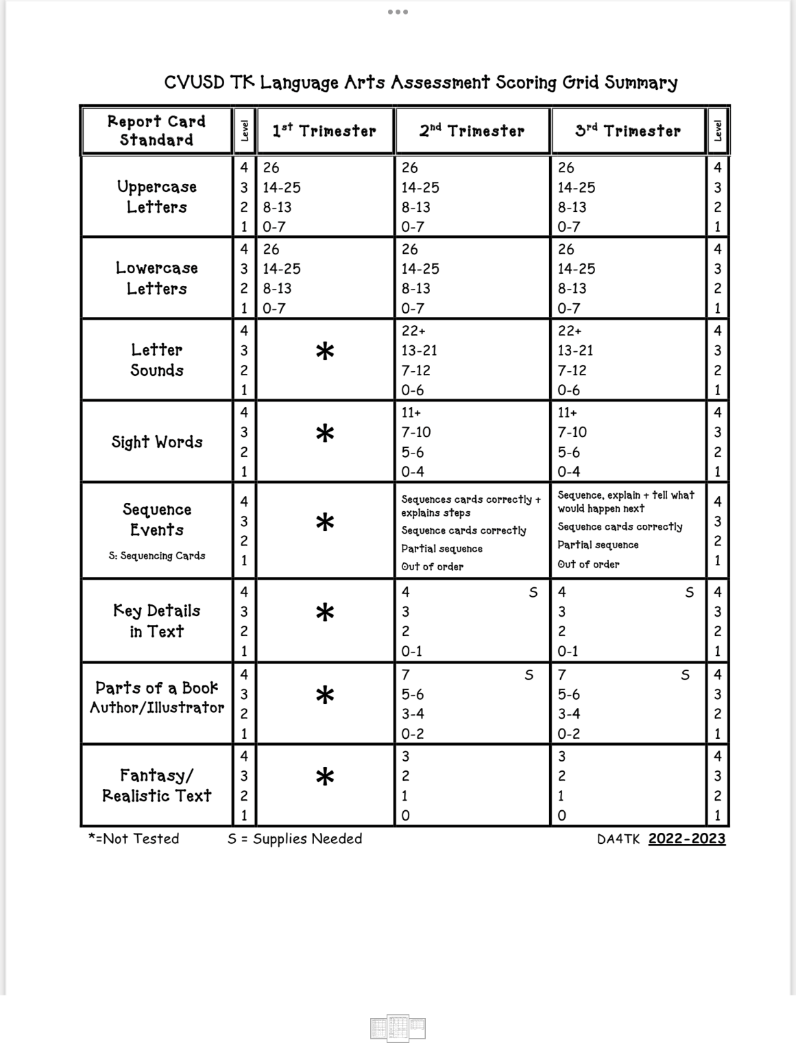
Language Arts Standards

Slide 7
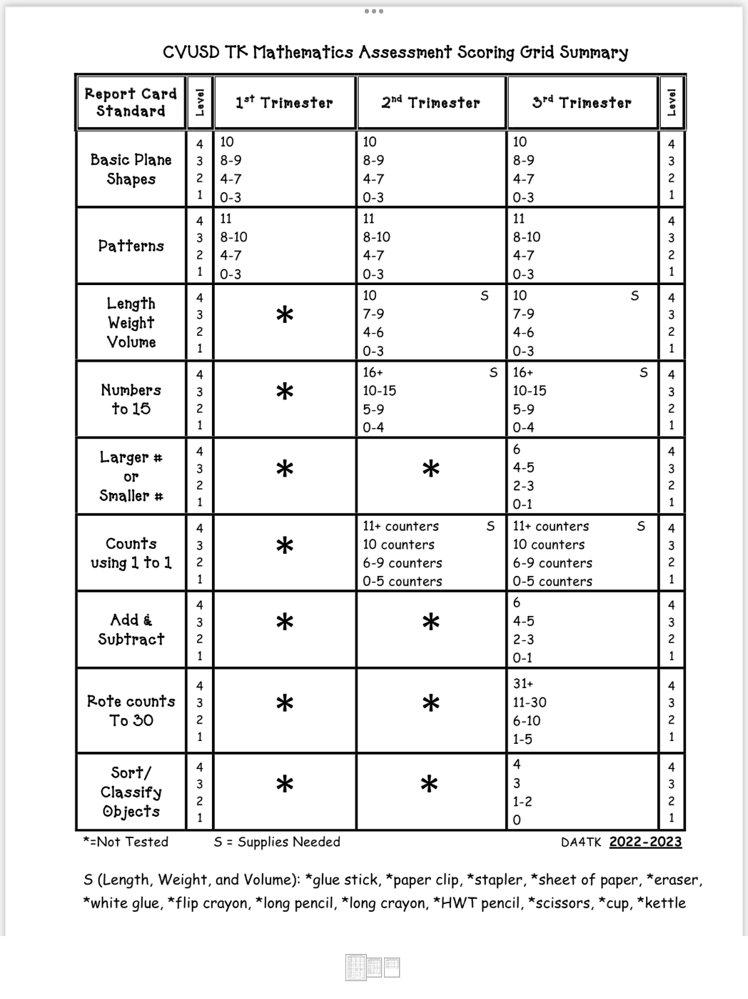
Math Standards

Slide 8
Handwriting Without Tears

Slide 9
Mathematics
“Math Their Way” Program
Free Exploration
Patterning
Sorting and Classifying
Counting/Comparing/Same or More
Graphing
Numbers/Symbolic Representation
Addition/Subtraction Sentences

Slide 10
Math - Patterns

Slide 11
Math Manipulatives

Slide 12
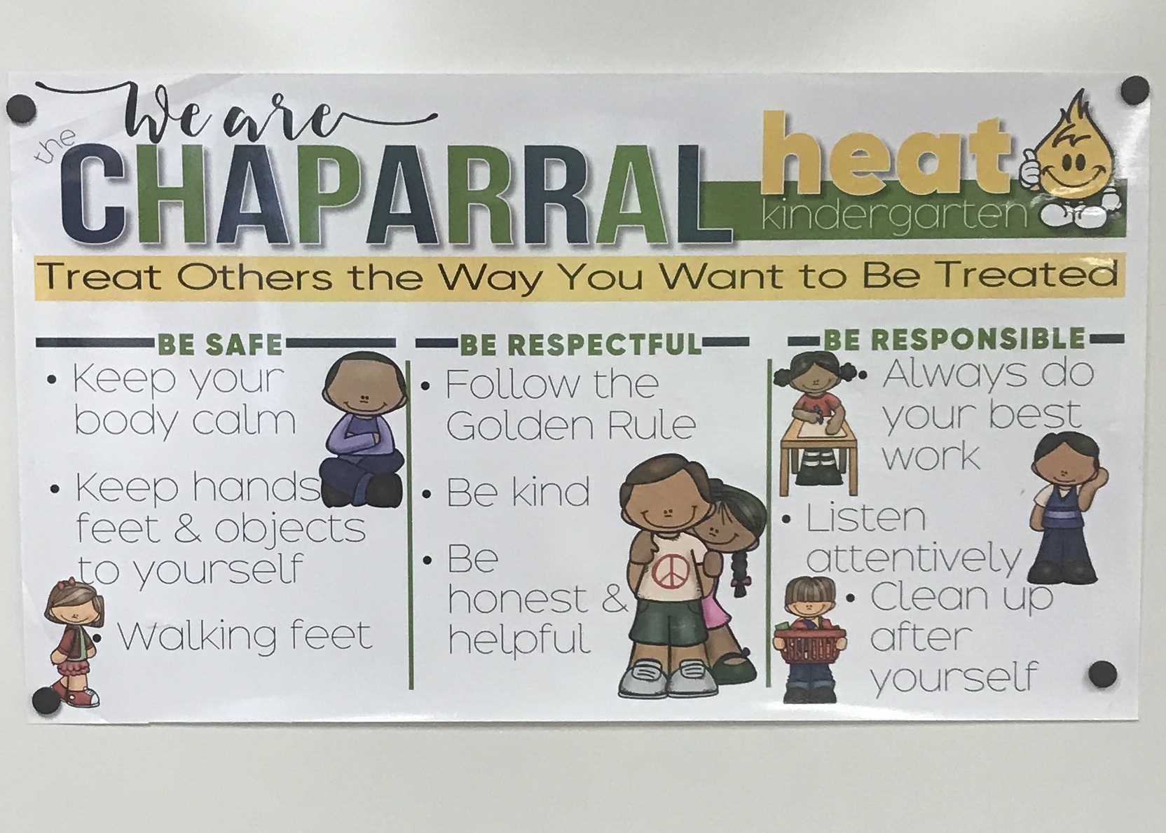
3 Be’s

Slide 13
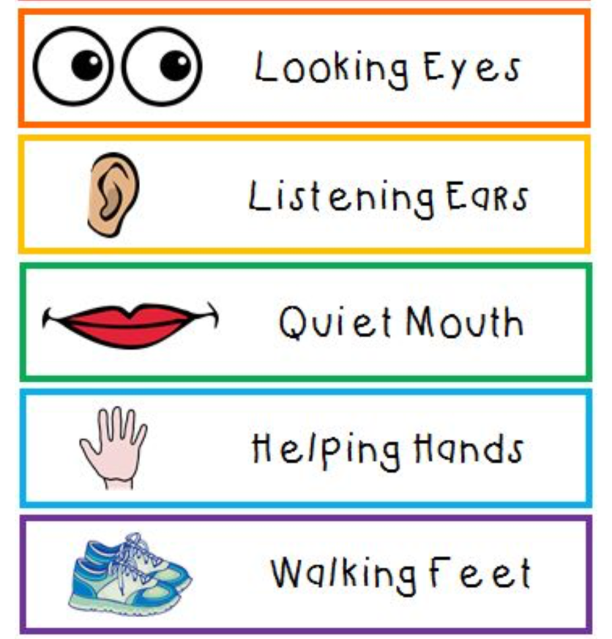
Classroom Management
“Clifford’s Classroom Rules”

Slide 14
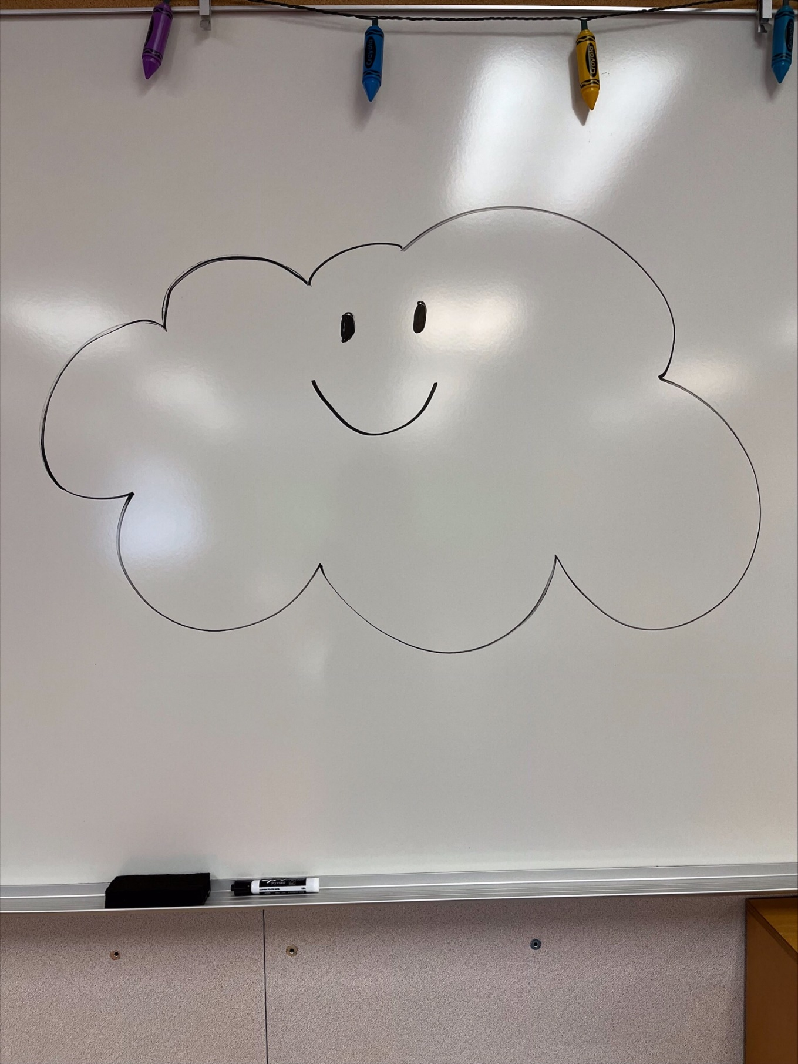
Happy Cloud

Slide 15
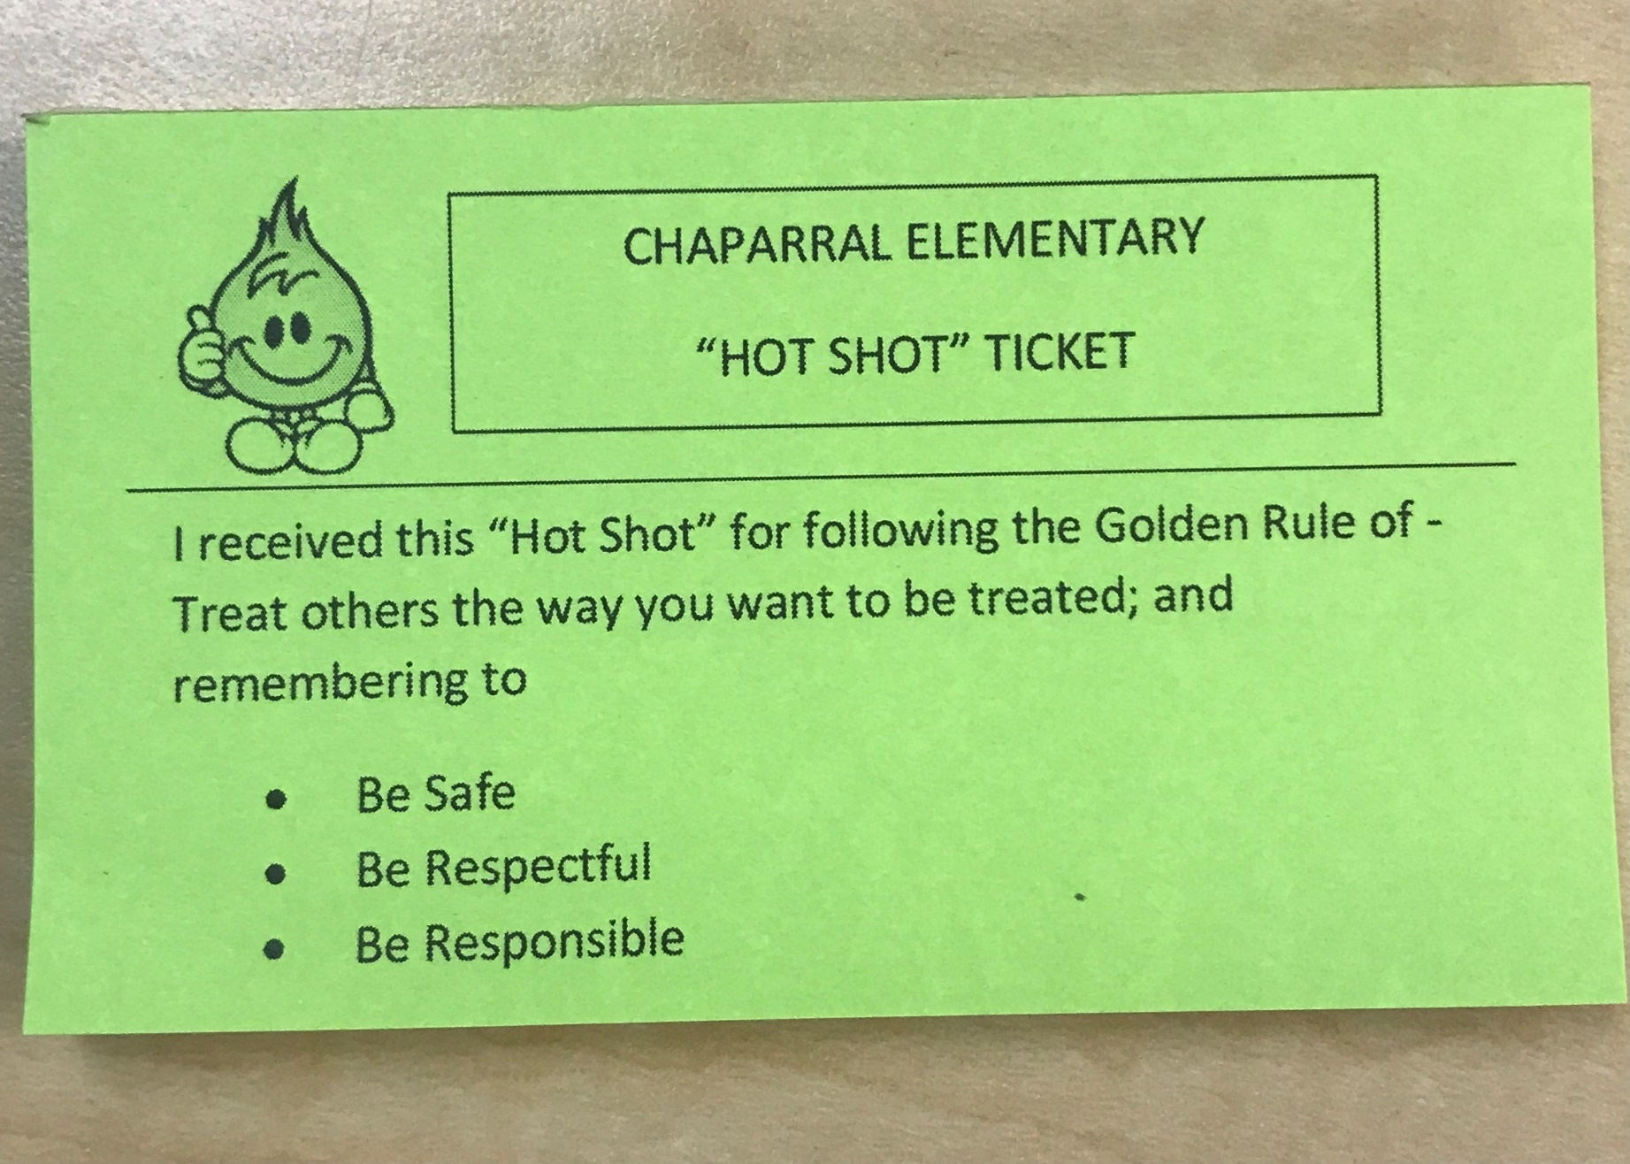
Hot Shots

Slide 16
Class Dojo

Slide 17
Grading
Parent Conferences week of September 25th – 29th
Regular Schedule for TK and K
Progress Reports six weeks into each trimester
Report Cards in October, February, and May

Slide 18
Homework
Daily Communication Folder
Average of 10-20 minutes a night
Monthly “Activity Calendar”
Monthly “Read Aloud”
Reinforcement of what your child learned in class

Slide 19
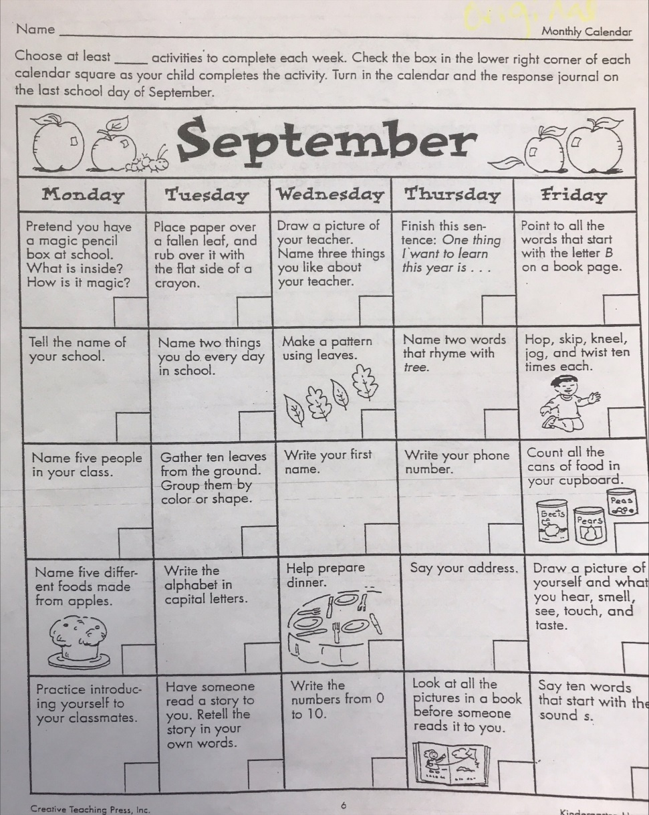
Monthly Activity Calendar

Slide 20
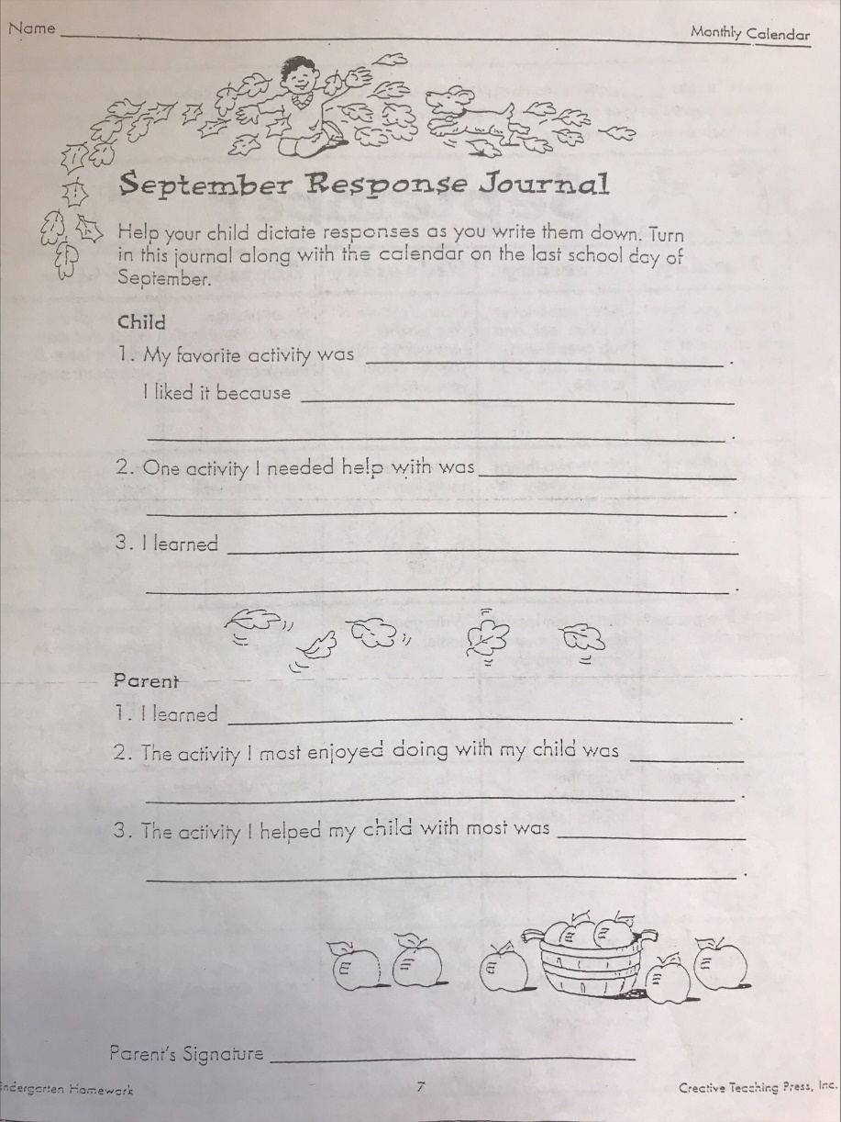
Response Journal

Slide 21
Monthly Read Aloud

Slide 22
Nutrition
We are a PEANUT FREE TK!
Students need to bring a simple snack in a lunch pail, labeled with their name. It should be finished within 10 minutes, allowing students to play and socialize.
Examples: cut fruit, cut vegetables, cheese, HALF a sandwich, water, juice.

Slide 23
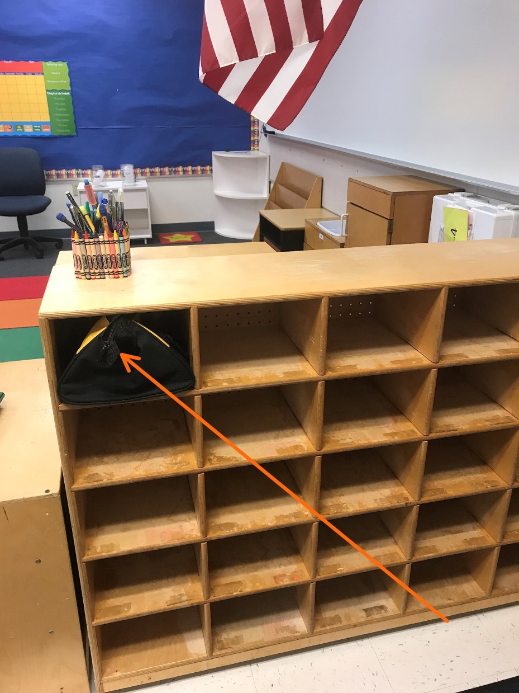
Student Snack Space

Slide 24
Scholastic Book Orders
Scholastic Book Orders
Monthly
Goal – one book per child
$1 books available
ONLINE ORDERING
EXCELLENT Behavior Incentive!
Earns credit toward TK classroom library

Slide 25
Birthdays
We will recognize each student’s birthday in class by receiving a Birthday Crown and singing a Birthday song.
A “Goodie Bag” with non-food items for the entire class will be acceptable but NOT required.
Absolutely NO cupcakes!

Slide 26
Arrival and Dismissal

Slide 27
Parent Volunteers
In class, preferably one parent daily, on a regular basis
Room Parent
Art Pals Person, monthly
Recycling Coordinator
Garden Volunteers – the more, the merrier :)
At Home Preparation

Slide 28
Raptor Technology

Slide 29
Parent Teacher Organization
Chaparral PTO
Not happening
How it can happen
We will need:
President
Vice President
Treasurer

Slide 30
Our Transitional Kindergarten Classroom

Slide 31
Thank you for attending Parent Information Night! Your participation is another step towards guiding your child to success in school.

